Slide 1
School Bus Grants
What you need to get ready

Slide 2
Table of contents
01
02
03
04
Information
Data
District Approval
Grants & Incentives

Slide 3
-United States Department of Transportation
“The school bus is the safest vehicle on the road—your child is much safer taking a bus to and from school than traveling by car.”

Slide 4
01
Information

Slide 5
TRUCRS
Annual Review
Every New Bus (Diesel greater than 14,000 lbs GVWR)
Compliance Status Certificate

Slide 6
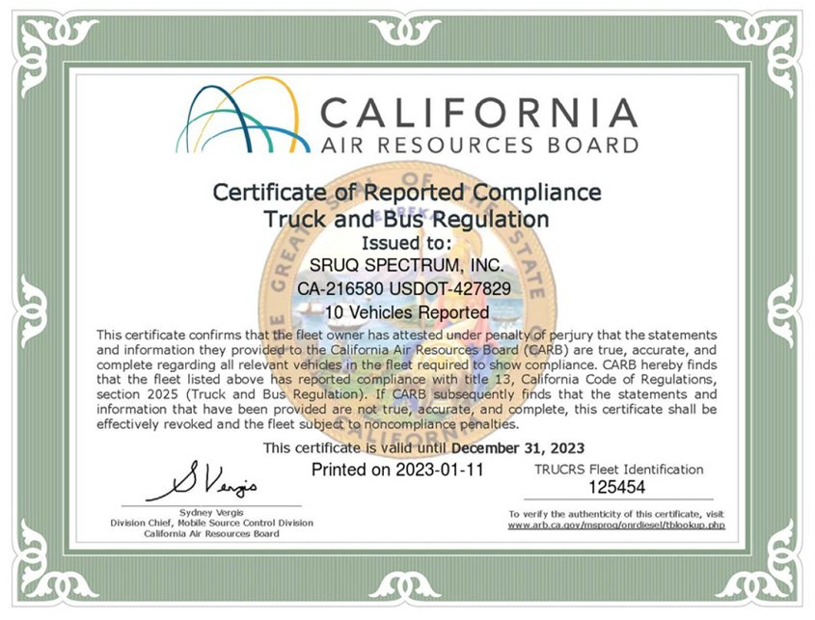
TRUCRS Certification

Slide 7
02
How to Prepare

Slide 8
Data - Track Grants
Track
What have you applied for:
VW Grant
Carl Moyer
EPA Grant
HVIP

Slide 9
Data - Bus Information
Bus ID
Year
Make
Model
VIN
License Plate
Fuel Type
Bus Type
Capacity (AMB/WC)

Slide 10
Addition Data
GVWR
Class Type
Condition
Status/Notes
Odometer Reading
Track Annual Mileage
Engine Family
Engine Manufacturer
Engine Year
Compliance Options

Slide 11
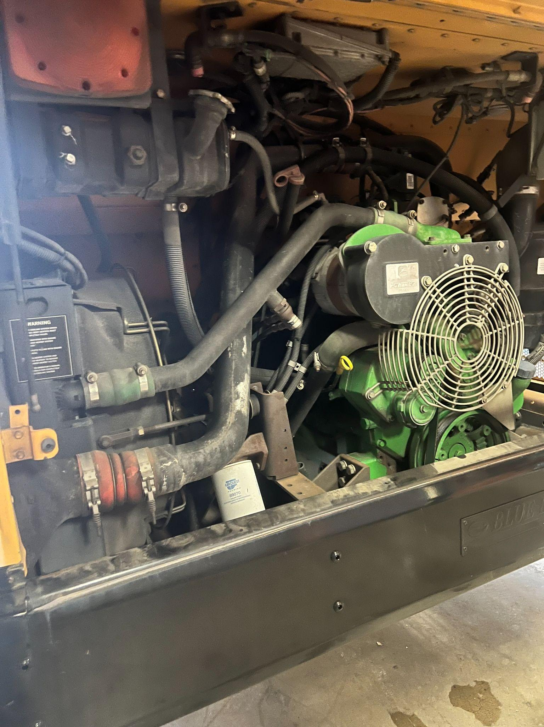
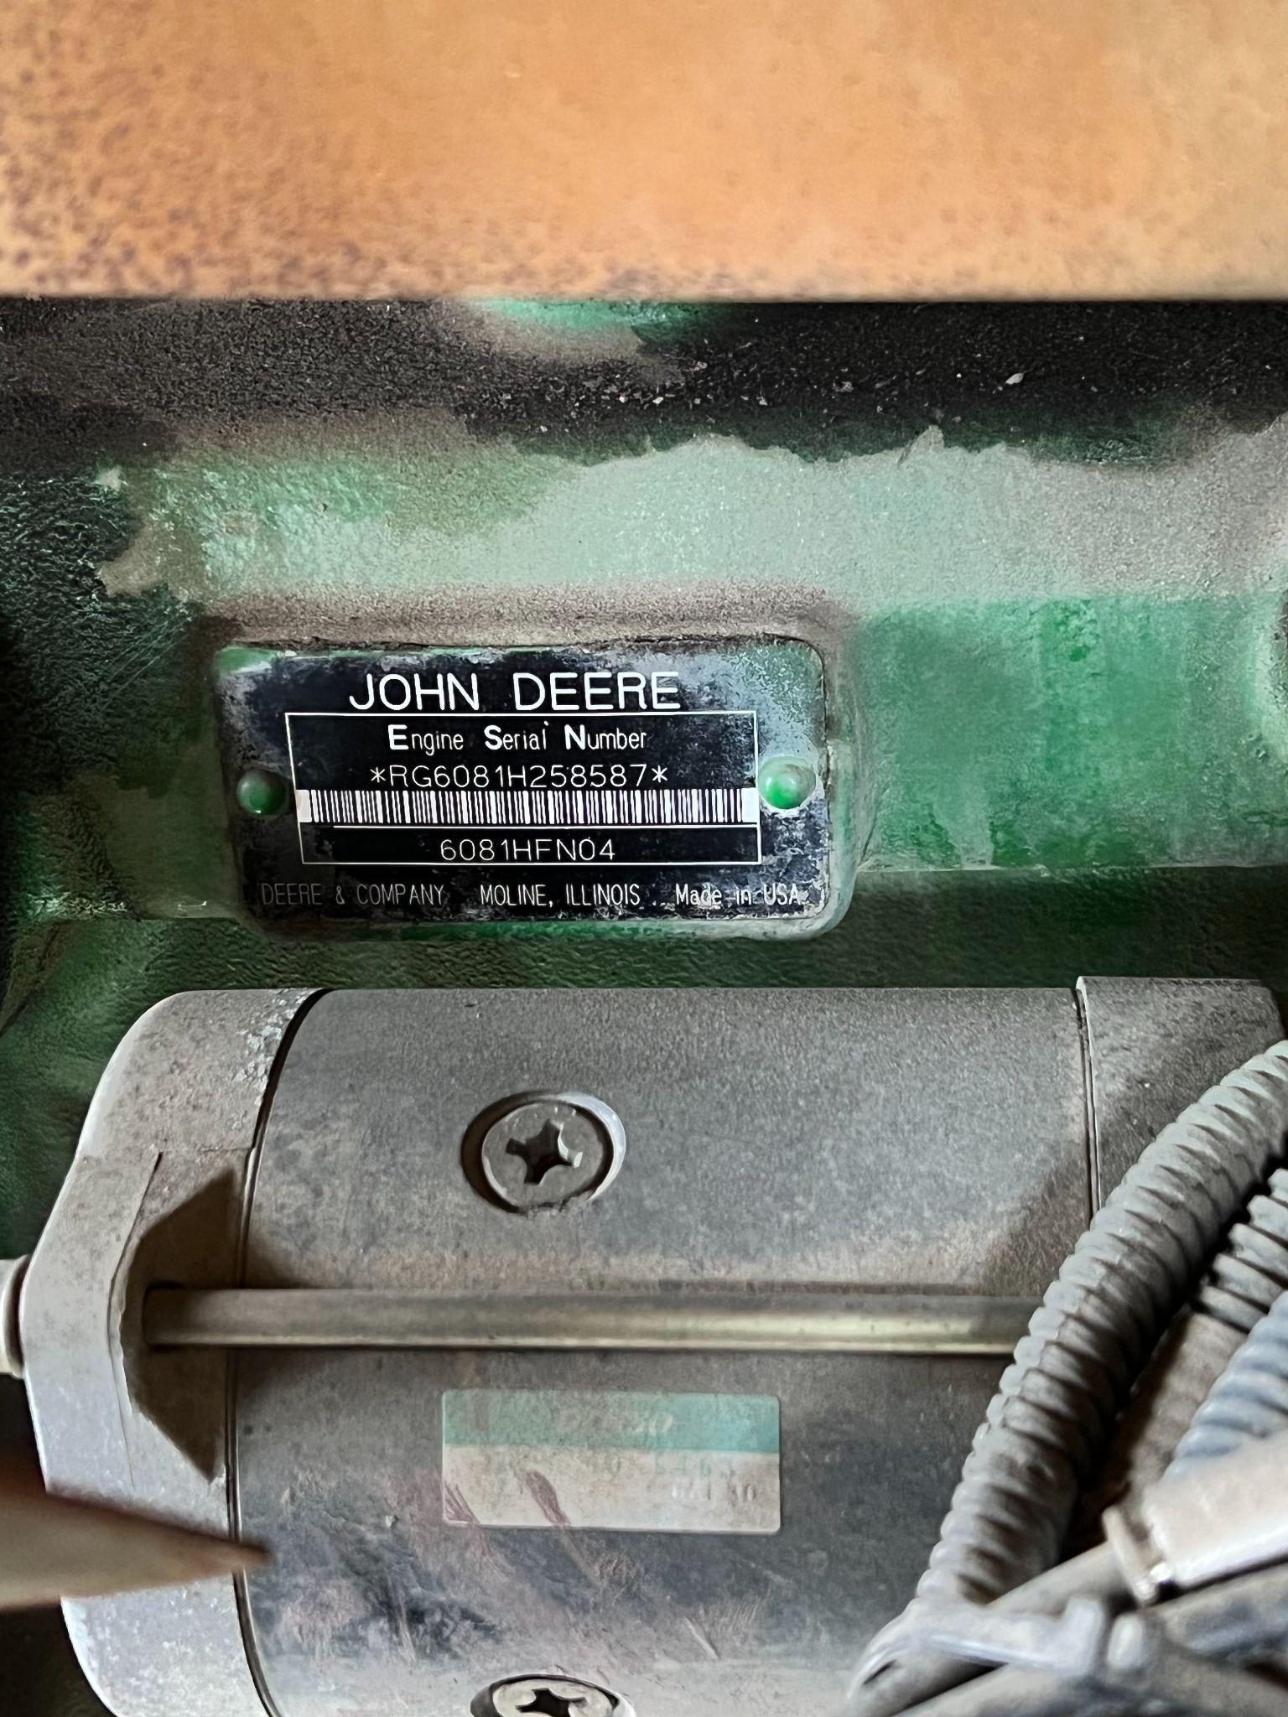
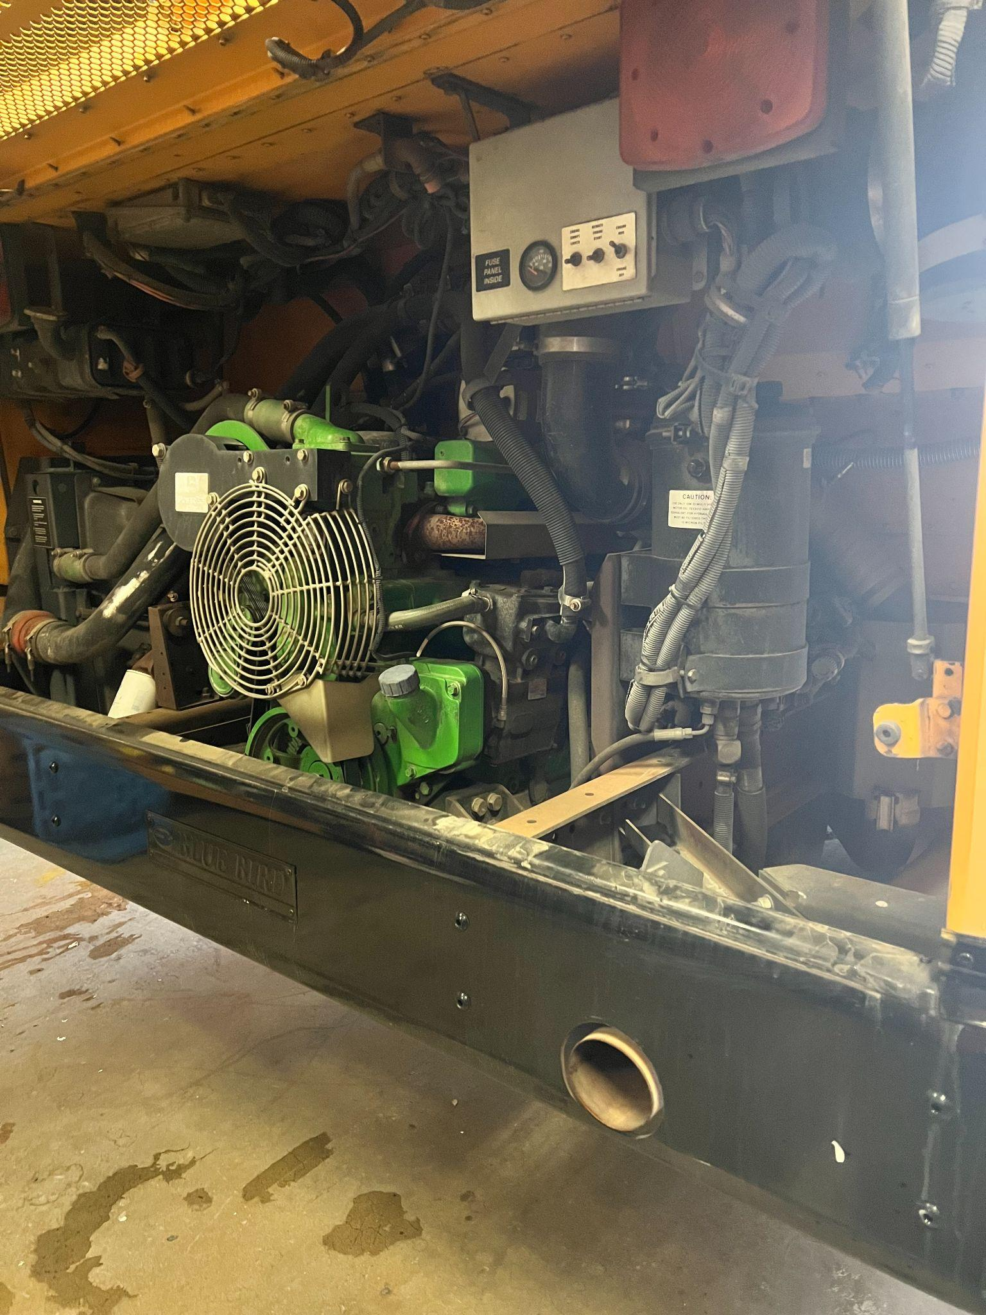
What other information should I gather

Slide 12
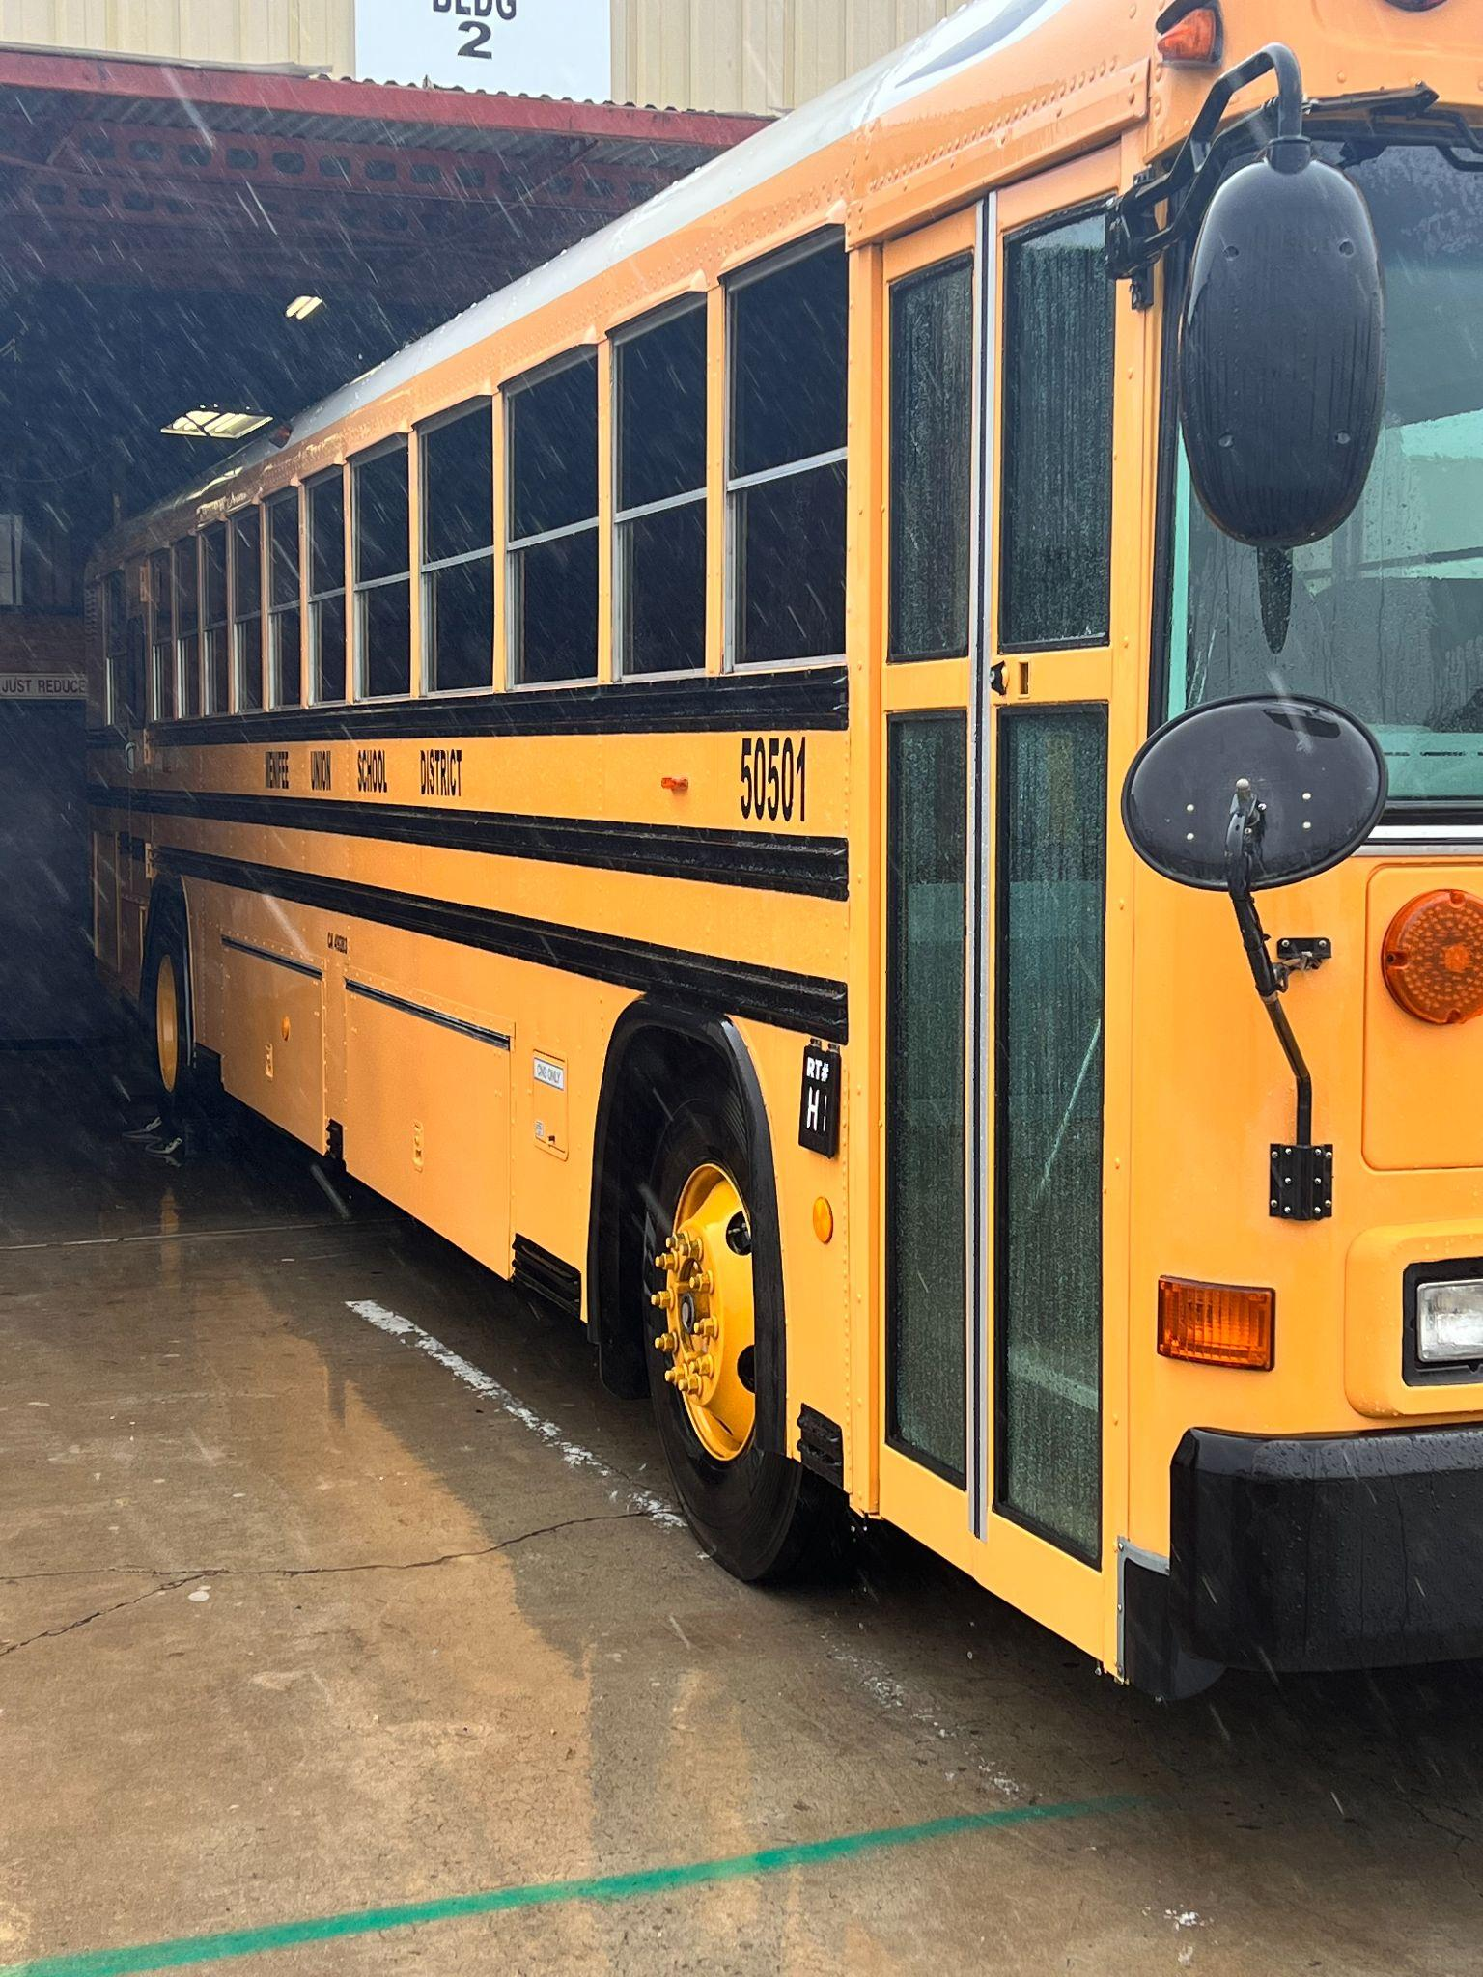
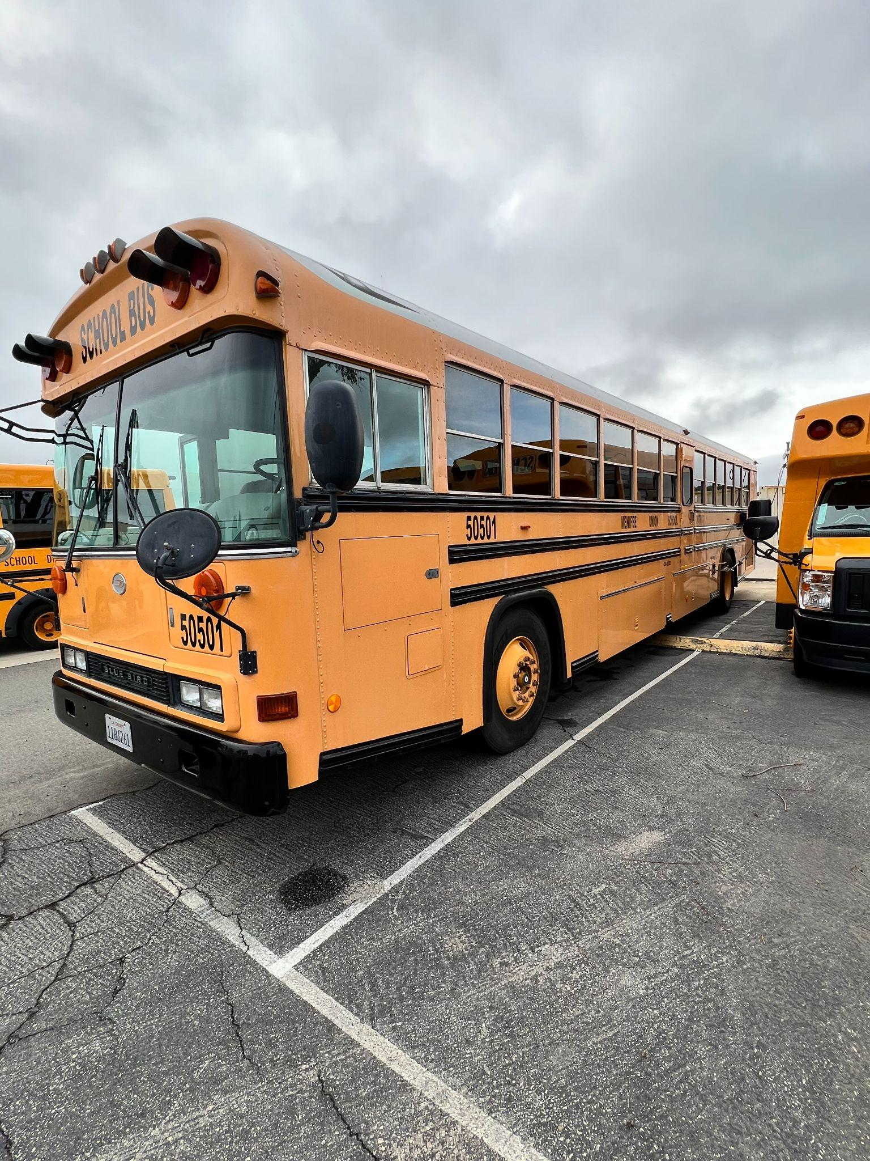
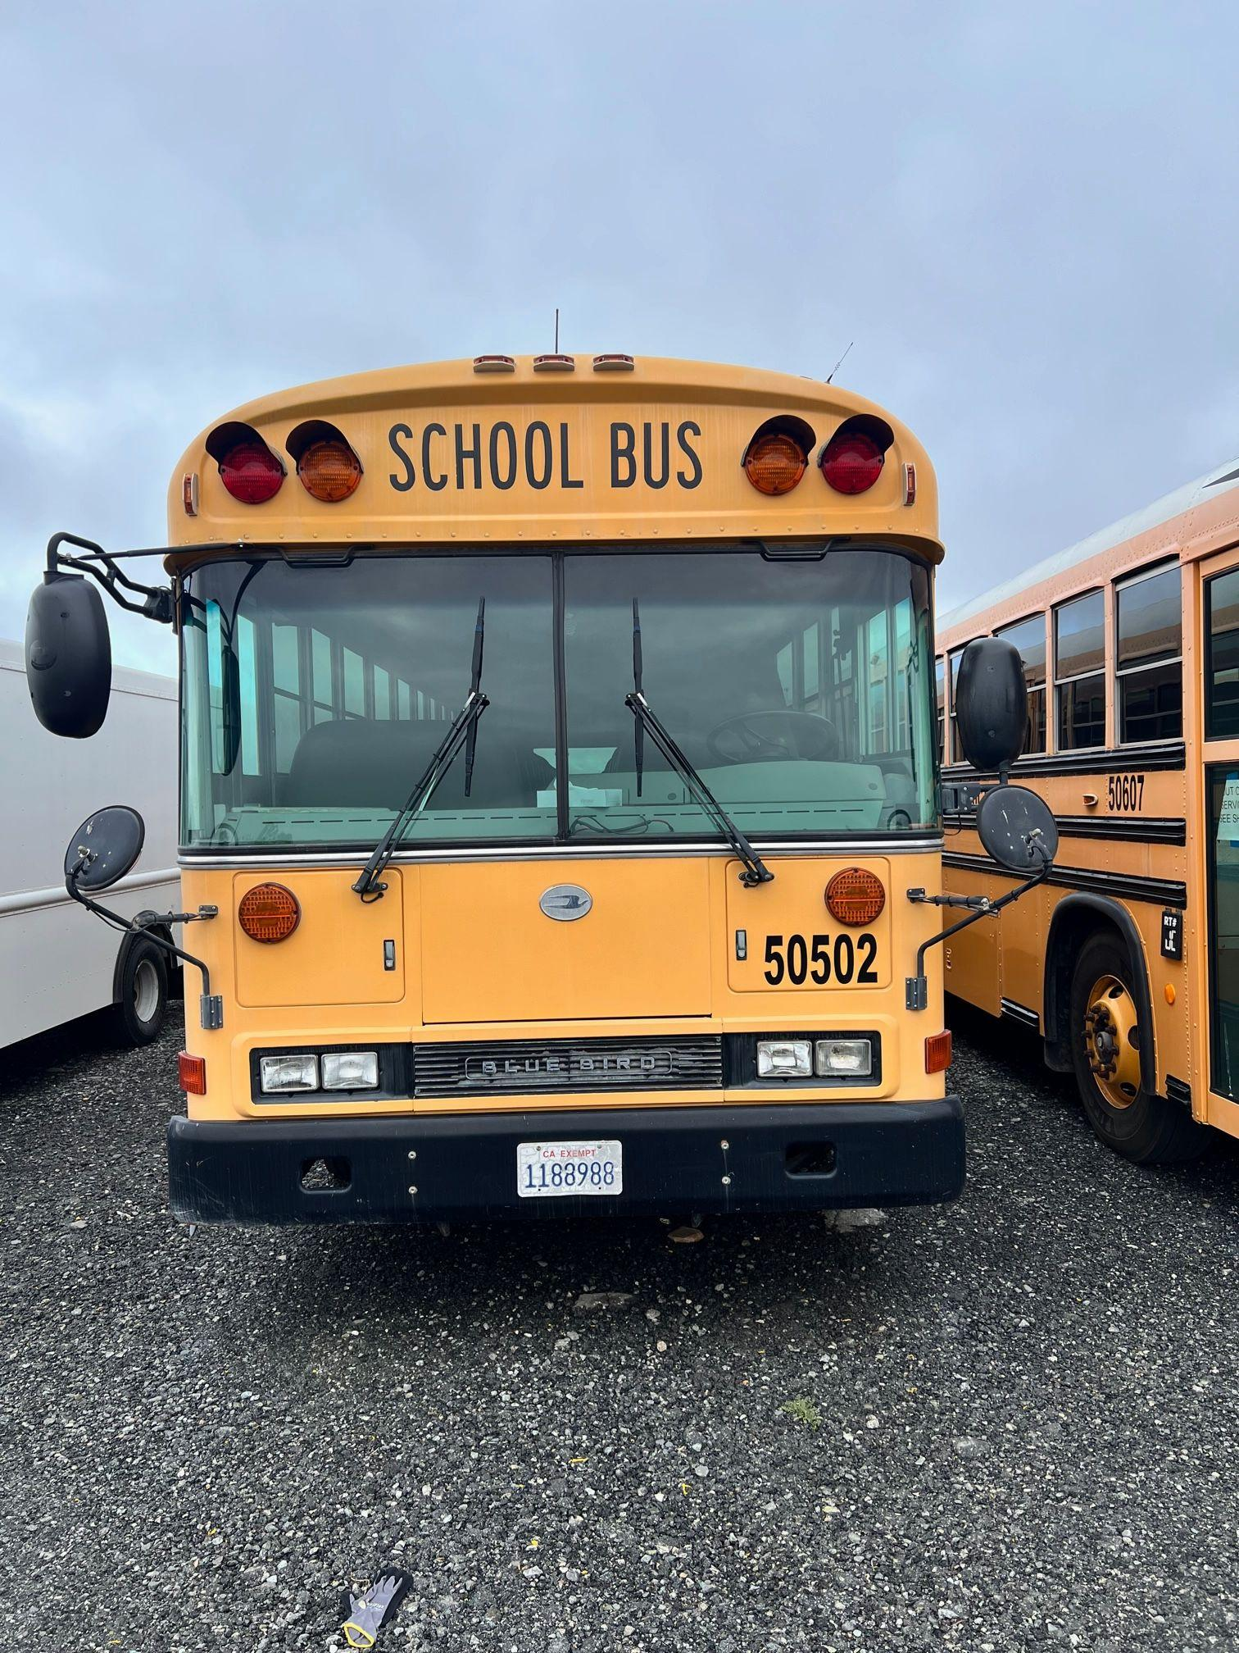
What other information should I gather

Slide 13
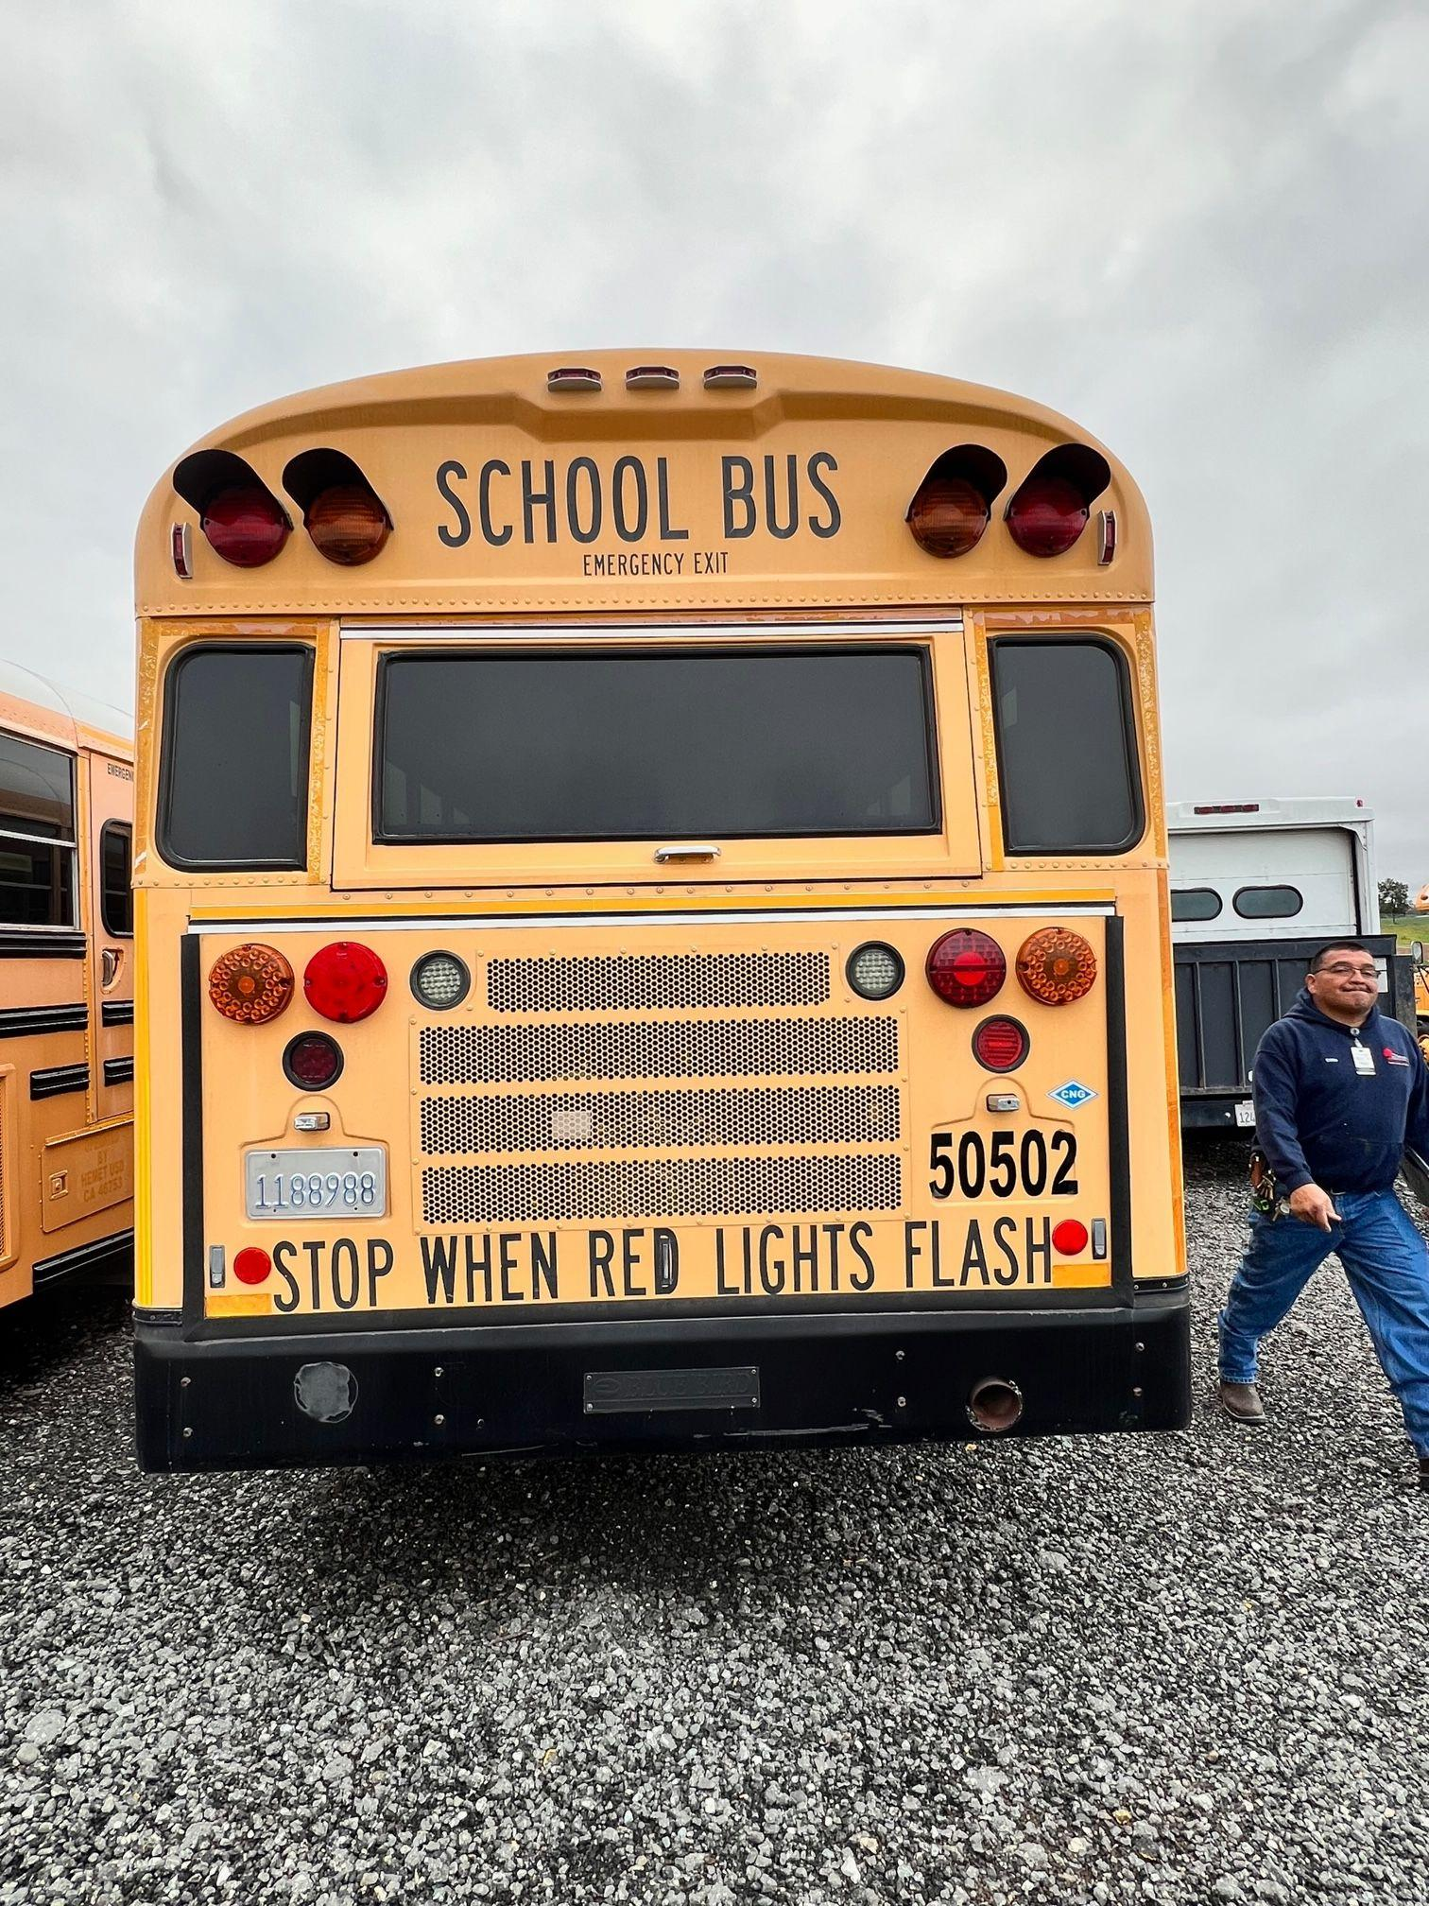
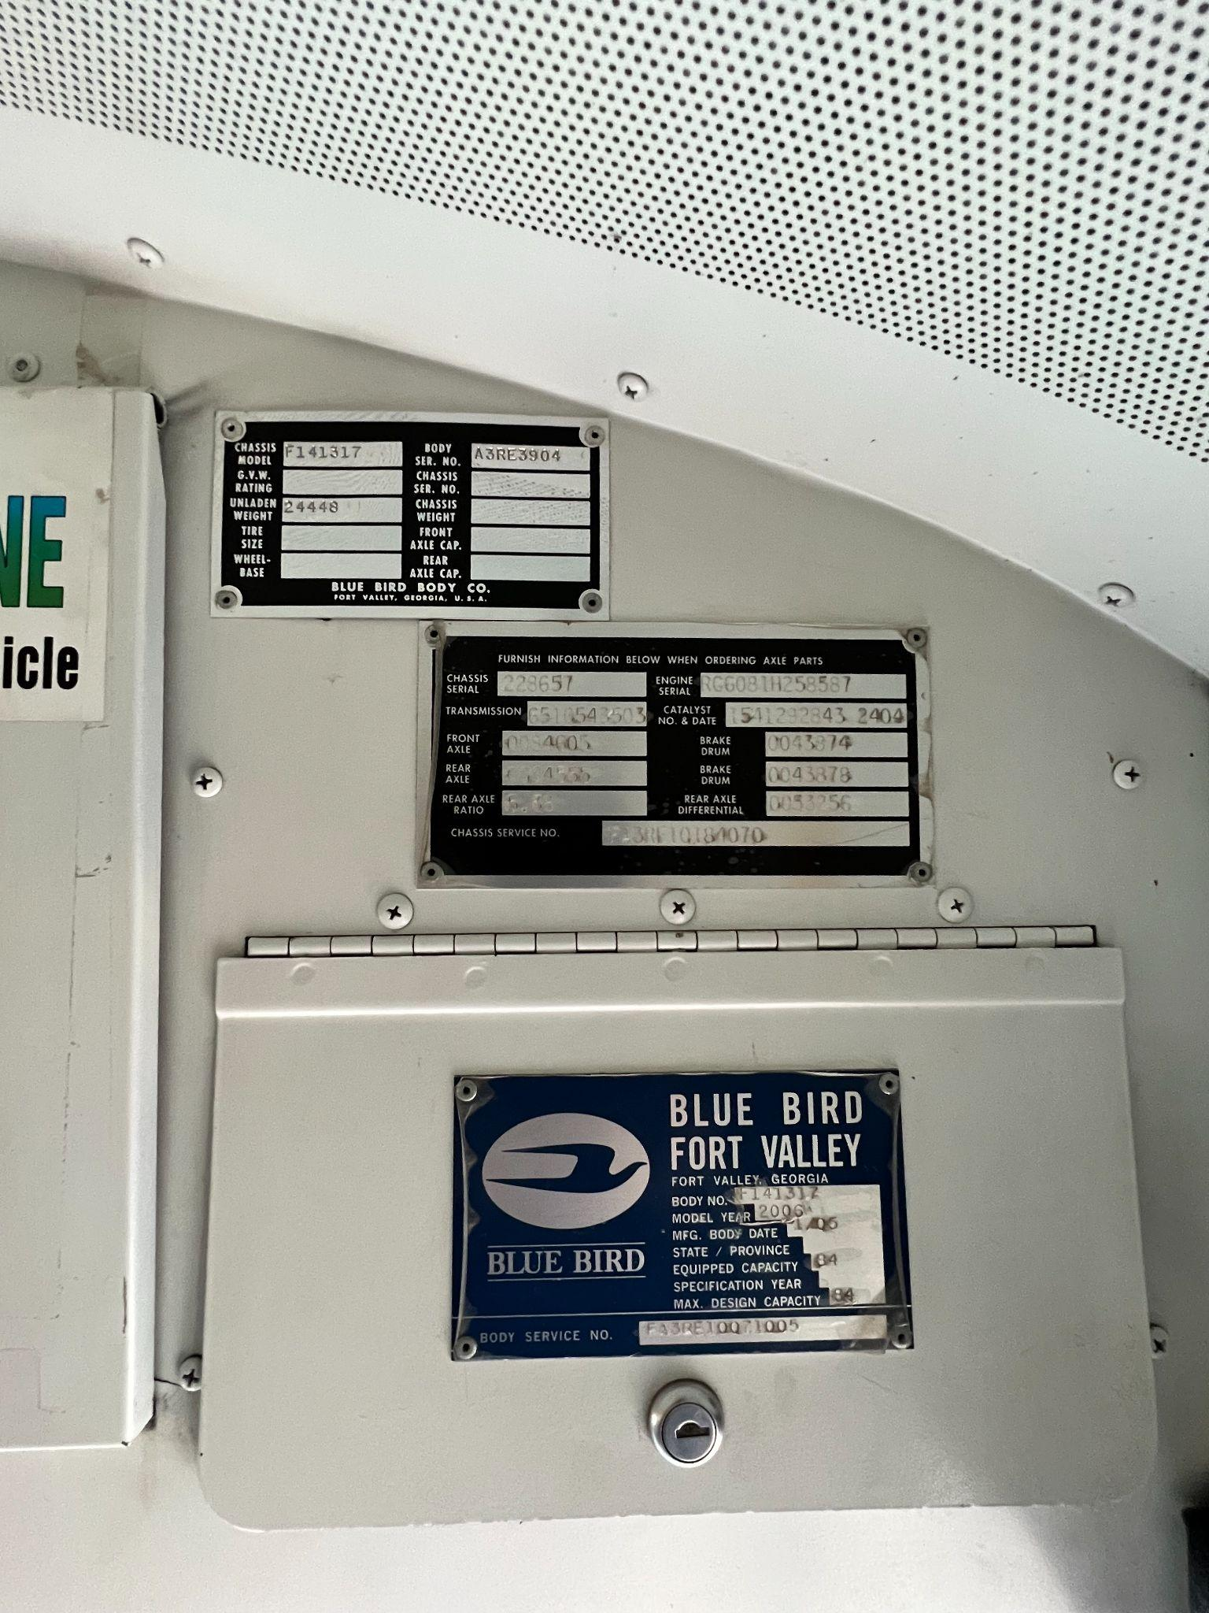
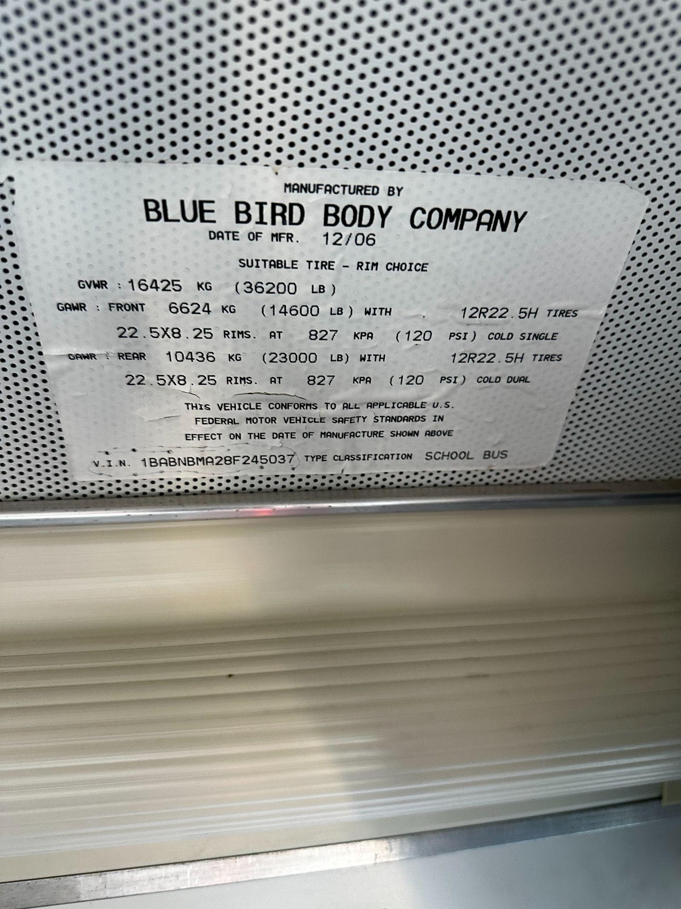
What other information should I gather

Slide 14
03
Approvals

Slide 15
District Approvals
Evaluate the Grant Opportunities
Board Resolution
Important Step for approvals
Authorization

Slide 16
Evaluate Grant(s)
See what’s out there
Make sure your district has the appetite to spend the additional funds
CONFIRM, CONFIRM, CONFIRM
Bring a “Green Vehicle” initiative to the board
Infrastructure
This needs to be a part of the plan
Find the right business partner

Slide 17
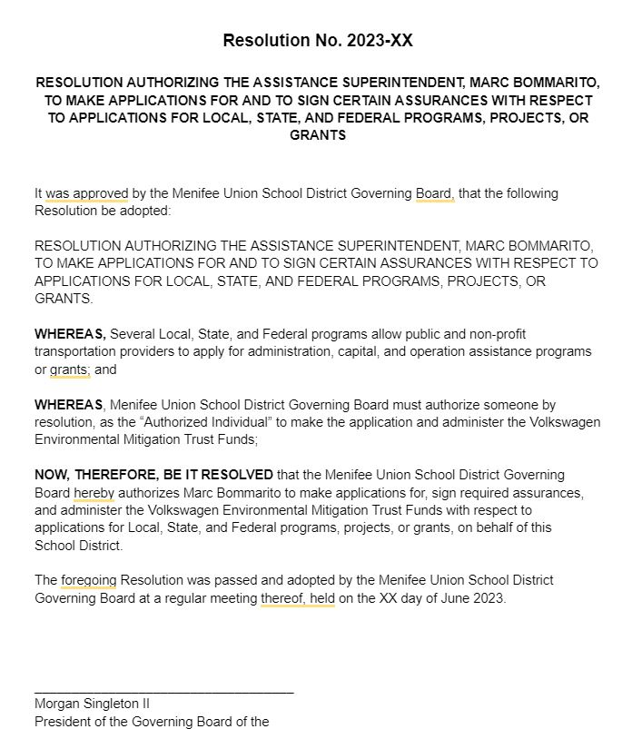
Board Resolution Sample

Slide 18
Timeline
Step 1
Step 3
Step 5
Evaluate Grant(s)
Apply for Grant(s)
TRUCRS
Review with CBO
Board Approval
Gather Information
Step 2
Step 4
Step 6

Slide 19
4
Grants & Incentives

Slide 20
Over the past 30 years
Managed the design and development of more clean fleet deployment projects than any other firm in North America | Overseen the development of some of the largest alternative fuel stations and corridors in the world | Secured more than $1 billion in grant funding for our clients with a 90% application success rate | Supported hundreds of clients in expanding brand reach, building market share, and achieving outreach goals
GNA clients include:
20

Slide 21
GNA Services
GNA works with clients to build the market for advanced transportation technologies and clean fuels.
Clean Fleet Strategy Achieve economic and environmental sustainability goals for public and private fleets | Creative & Events Build brand awareness, influence key decisionmakers, and increase project success and market share | Funding & Incentives Maximize the financial benefits of advanced vehicles and clean fuels
Policy & Regulatory Support Navigate regulatory and legislative initiatives that impact the commercial transportation sector and progress towards sustainability | Market Analysis & Development Assess the market landscape for clean transportation and energy products and services | Sustainability Strategy Establish a comprehensive sustainability strategy to future-proof your operations and deliver benefits across your value chain

Slide 22
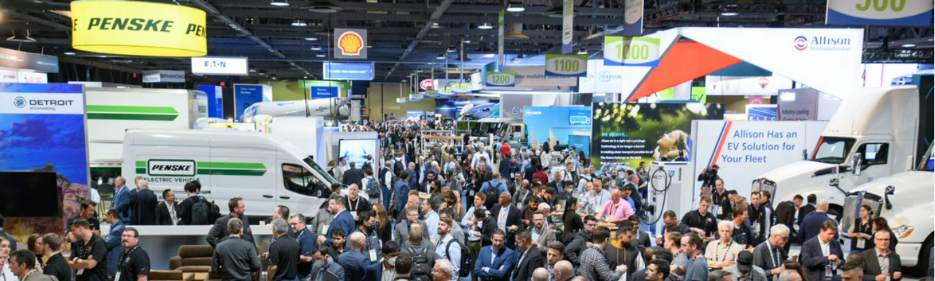
Advanced Clean Transportation Expo
May 20 to 23, 2024 | Las Vegas Convention Center
GNA produces North America’s largest advanced transportation and clean fleet event. www.actexpo.com
12,000+ Registered Attendees | 2,700+ Fleet Operators | 275+ Sponsors & Exhibitors

Slide 23
California AB 579
Signed into law by Governor Newsom on October 8, 2023
Starting January 1, 2035 – 100% of all newly purchased or contracted school buses of a school district, county office of education, or charter school to be zero-emission vehicles, where feasible.
One time extension for a term not to exceed 5 years if a local educational agency determines that the purchase or contracting of a zero-emission school bus is not feasible due to both terrain and route constraints, provided that certain conditions are met.
How does this impact Grants?
In California, Grants can’t be used to fund anything required by a regulation. Come 2035, many of these grant programs won’t be able to deploy zero-emission school buses.

Slide 24
How to Differentiate Incentive Programs
Geographic requirements
Funding Levels (how much funding is available per bus, total funding)
Timing (First Come/First Serve, Competitive)
Funding Mechanism (Rebate, Grant, Tax Credit)
Scrappage Requirements (Model Year, Fuel Types, Operations)
Deployment Requirements (When ZE buses need to hit the road)
Eligible Equipment (Buses: Type A-D, Infrastructure: Chargers, Installation, Battery Energy Storage Systems, Solar, etc.)

Slide 25
4.1
Federal Programs

Slide 26
EPA Clean School Bus (Rebates)
Type: Rebate
Style: Data Driven
Geography: United States
Timing: Lottery
Open: September 28, 2023 Close: January 30, 2024
Award: April, 2024
Total Funding: $500,000,000+
Equipment: Type A-D, L2/DCFC
Bus $: $145,000 - $345,000
EVSE $: Combined with Bus Award
Max Applicant Funding: 25 buses
Scrappage: Yes, Model Year flexibility exists for electric projects (including LPG/CNG/Gas buses)
Opens
(9/29)
Closes
(1/31)
Award
(April)
Q4 2023
Q1 2024
Q2 2024
Q3 2024
https://www.epa.gov/cleanschoolbus/clean-school-bus-program-rebates

Slide 27
EPA Clean School Bus (Grants)*
*Under Development
Type: Grant
Style: Narrative
Geography: United States
Timing: Competitive
Open: Q2 2024* Close: Q3 2024*
Award: Q4 2024-Q1 2025*
Total Funding: $400,000,000*
Equipment: Type A-D, L2/DCFC
Bus $: $145,000 - $345,000*
EVSE $: Combined with Bus Award
Max Applicant Funding: 50-100 buses*
Scrappage: Yes, Model Year flexibility exists for electric projects (including LPG/CNG/Gas buses)
Opens
(Q2)
Closes
(Q3)
Award
(Q4-Q1)
Q2 2024
Q3 2024
Q4 2024
Q1 2025
https://www.epa.gov/cleanschoolbus/clean-school-bus-program-grants

Slide 28
IRS Commercial Clean Vehicle
Tax Credit*
*Under Development
Businesses and tax-exempt organizations that buy a qualified commercial clean vehicle may qualify for a clean vehicle tax credit of up to $40,000.
There is no limit on the number of credits your business can claim.
The form has not yet been finalized by the IRS.
You need the new vehicle VIN to submit the form.
Type: Tax Credit
Timing: Expected Q4 2023
Bus $: Depends on vehicle size
GVWR < 14,000 lbs: $7,500
GVWR > 14,000 lbs: $40,000
Consult a tax professional!
IRS Publishes Form
(Q4 2023)
Submit Form once Vehicles are Deployed
Q4 2023
Q1 2024
Q2 2024
Q3 2024
https://www.irs.gov/credits-deductions/commercial-clean-vehicle-credit

Slide 29
4.2
State Programs

Slide 30
HVIP: Standard & School
Bus Set-Aside
HVIP (standard) is a point-of-sale voucher program that does not require scrappage of an existing school bus
The School Bus Set-Aside is a sub-program to HVIP that is only open to School Districts in Small or Medium sized Air Districts and does require scrappage of a MY 2010 or older ICE school bus
Excludes Bay Area, San Diego, Sacramento, San Joaquin Valley, and South Coast
The School Bus Set-Aside increases the funding per bus
$60,000-$120,000 → $285,000-$395,000
Another $375 million will be added to the funding totals for electric school buses in FY 23-24 through

Slide 31
HVIP: School Bus Set-Aside
Potential for Joint Application with EnergIIZE
Type: Voucher
Style: Data Driven
Geography: Small/Medium Air Districts in California
Timing: First Come, First Serve Open: June 20, 2023 Close: September 29, 2023
Award: Pending, 2-3 months
Total Funding: $117,000,000
Equipment: Type A-D
Bus $: $285,000 - $395,000
Max Applicant Funding: 30 buses/year
Scrappage: Yes, MY 2010 or older ICE bus
Opens
(6/20)
Closes
(9/29)
First Come, First Serve
Q1 2023
Q2 2023
Q3 2023
Q4 2024
https://californiahvip.org/purchasers/#SchoolBus

Slide 32
EnergIIZE - Fast Track*
*Under Development
Type: Grant
Difficulty: Narrative
Geography: California
Timing: First Come, First Serve
Open: Q1 2024 (February)* Close: FC, FS (Same day)
Award: Q2 2024*
Total Funding: $10,400,000*
Equipment: L2 and DCFC
EVSE $: Up to 50% of eligible costs, 75% if in a DAC/LIC
Max Applicant Funding: $500,000, $750,000 if you are in a DAC/LIC
Opens
(Q1)
Award
(Q2)
Q1 2024
Q2 2024
Q3 2024
Q1 2025
www.energiize.org

Slide 33
EnergIIZE - Jump Start*
*Under Development
Type: Grant
Difficulty: Narrative
Geography: Located in DAC/LIC**
**https://oehha.ca.gov/calenviroscreen/report/calenviroscreen-40
Timing: Competitive
Open: Q3 2024 Close: Q3 2024
Award: Q4 2024
Total Funding: $25,000,000*
Equipment: L2 and DCFC
EVSE $: Up to 75% of eligible costs
Max Applicant Funding: $750,000
Opens/Closes
(Q3)
Q2 2024
Q3 2024
Q4 2024
Q1 2025
www.energiize.org

Slide 34
4.3
Local Programs

Slide 35
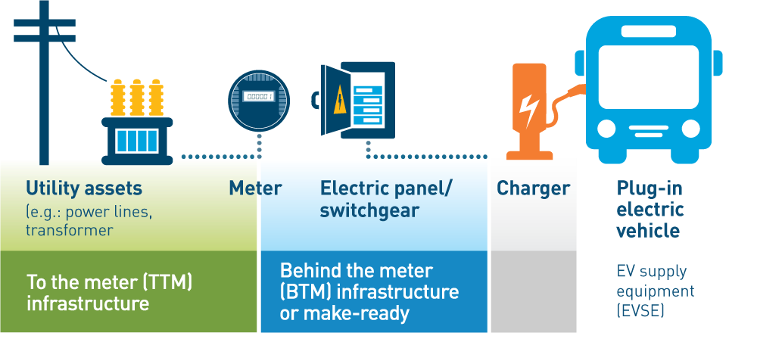
Utility Programs
One of the most important pieces of the electric puzzle
Dependent on who your electric Utility is
PG&E, SCE, SDG&E have the most robust “Make-Ready” programs
Covers behind the meter infrastructure, can vary based on project specifics but up to 80% of eligible costs
Additionally, each utility offers charger rebates of up to 50% of eligible costs for school bus projects (i.e., charger, pedestal)
Utility timelines can range and be upwards of 24+ months to complete necessary electrical upgrades
Chargers Activated
Start Conversation with Utility
Submit Application
Q4 2023
Q1 2024
Q3 2025
https://www.pge.com/en_US/large-business/solar-and-vehicles/clean-vehicles/ev-fleet-program/public-school-fleets.page /
https://www.sdge.com/business/electric-vehicles/power-your-drive-for-fleets / https://crt.sce.com/overview

Slide 36
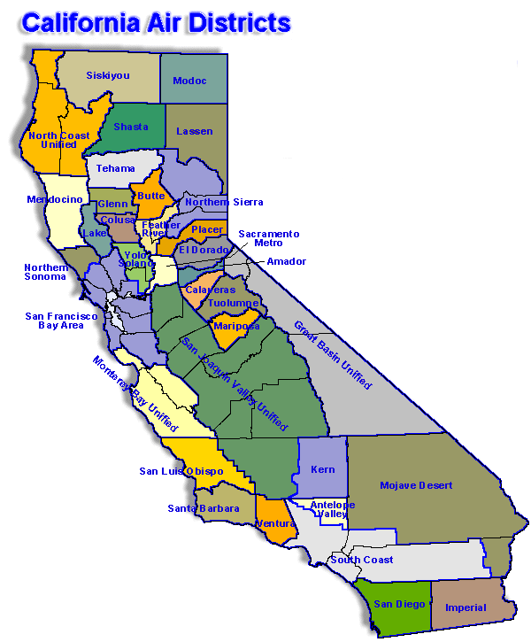
Carl Moyer Program
Funding from the Air Resources Board is distributed to local Air Districts (larger ADs have more funding).
Specific program details can vary by Air District but base guidelines are determined by CARB.
Can fund both school buses and EV charging infrastructure and solar. Scrappage of existing, owned, buses is required.
Grant award for buses is based on a cost-effectiveness calculations using existing buses’ age and annual mileage for the last 2 years. The older the bus and more miles the closer to 100% of costs can be covered.
Funding for infrastructure can be up to 100% of eligible project costs (Solar, BESS, Chargers, etc.)
https://ww2.arb.ca.gov/our-work/programs/carl-moyer-memorial-air-quality-standards-attainment-program

Slide 37
Carl Moyer Program – Bay Area*
*Under Development
Type: Grant
Difficulty: Narrative
Geography: Bay Area Counties
Timing: First Come, First Serve
Open: October 2023* Close: FC, FS (May 2024)
Award: 3-6 Months*
Total Funding: $50,000,000+*
Equipment: Type A-D, L2/DCFC
Bus $: $50,000 - $410,000
EVSE $: 100% of eligible costs
Max Applicant Funding: EVSE at $1,000,000, No bus limit
Scrappage: Yes, no MY requirement for school buses (older the better)
Opens
(October)
Closes
(Q2)
First Come, First Serve
Q4 2023
Q1 2024
Q2 2024
Q3 2024
https://www.baaqmd.gov/funding-and-incentives/businesses-and-fleets/school-buses

Slide 38
Carl Moyer Program - Timing
Opens
(6/13)
First Come, First Serve
Central Valley
Q2 2023
Q3 2023
Q4 2023
Q1 2024
Opens (Q4)
First Come, First Serve
Sacramento*
Q4 2023
Q1 2024
Q2 2024
Q3 2024
Opens (Q1)
Closes (Q1)
Award (Q3)
San Diego*
Q1 2024
Q2 2024
Q3 2024
Q4 2024
Opens (Q1)
Closes (Q2)
Award (Q4)
South Coast*
Q1 2024
Q2 2024
Q3 2024
Q4 2024

Slide 39
Potential Scenarios*
*Depending on project specifics and grant timing
School District “ABC”
Assuming a priority classification under EPA CSB, in a large air district, has existing buses to scrap
School Buses: EPA CSB Rebates (2023), applies for 25 buses, $345K/bus = $8,625,000
Infrastructure: Carl Moyer program, applies for 25 chargers* = Up to 100% of eligible costs covered
*Chargers, design/engineering, energy storage, installation, renewable energy
Utility: SCE Charge Ready Transport = Up to 80% of make-ready costs, up to 50% of eligible charger costs
School District “DEF”
Assuming not a priority classification under EPA CSB, in a small air district, has existing buses to scrap
School Buses: HVIP School Bus Set-Aside, applies for 15 buses, $370K/bus = $5,550,000
Infrastructure: EnergIIZE, applies for 15 chargers* = Up to 75% of eligible costs covered
*Chargers, design/engineering, installation
Utility: PG&E EV Fleet = Up to 80% of make-ready costs, up to 50% of eligible charger costs

Slide 40
Timeline
Step 1
Step 3
Step 5
Evaluate Grant(s)
Apply for Grant(s)
TRUCRS
Review with CBO
Board Approval
Gather Information
Step 2
Step 4
Step 6

Slide 41
Thank You!
Cary Welsh, Sr. Program Manager
cwelsh@trccompanies.com - 424.280.2772
http://gladstein.org

